Slide 1

Medicines Side Effect Analysis
Team 5
27 /05/2021

Slide 2
Team Members:
Sadhana Srinivasan
Shabaz Shariff
Pavan K M
Aravind Bajantri
Chaitra Ganesh
Adithya S Bharadvaj
Mohana K N
Project Mentor
Vinod

Slide 3
Business Problem:
Objective:
This product could be helpful for companies like 1mg to provide detailed rating of the side effects of the product over their site. It could also be helpful for the patients who are buying drugs online to check the side effects of the drugs before buying it.

Slide 4
Dataset:
Data Source: Druglib and DrugBank

Slide 5
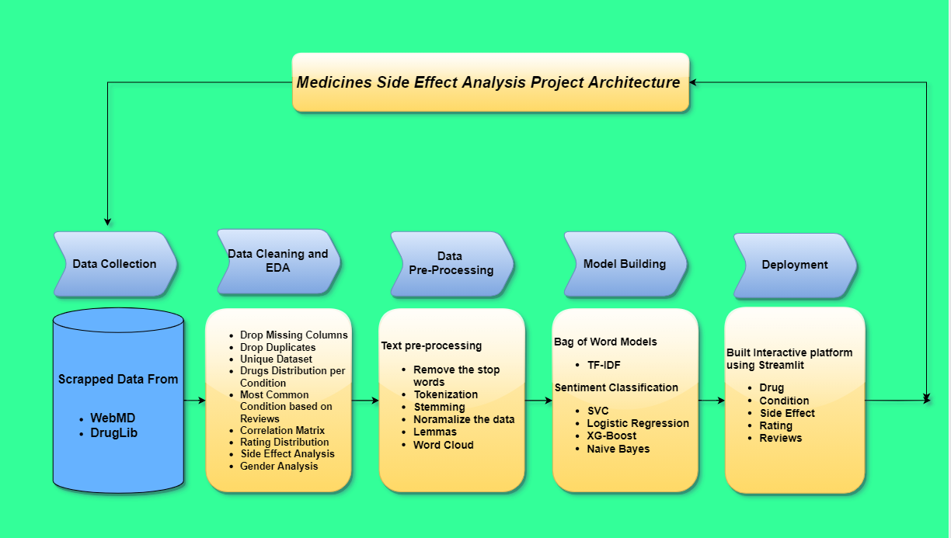
Project Architecture / Project Flow

Slide 6
Exploratory Data Analysis (EDA) and
Feature Engineering

Slide 7
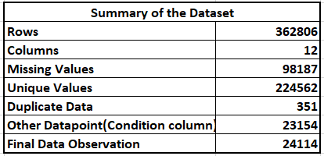
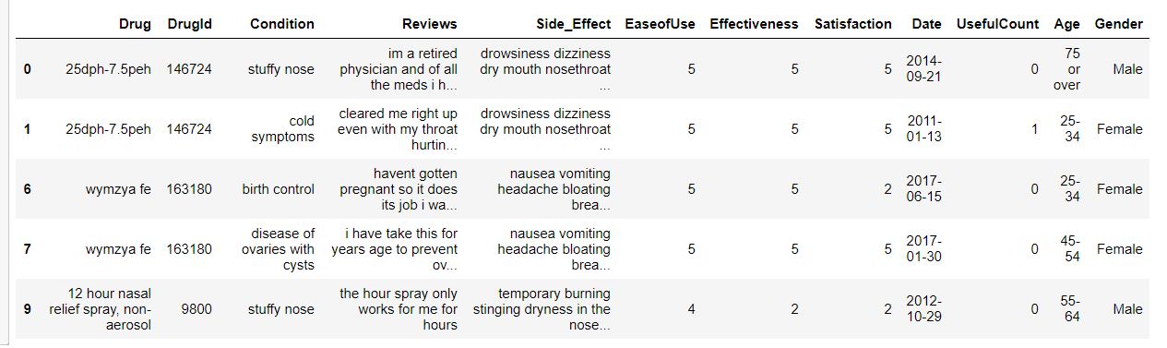
Data set details:
EDA – Webmd dataset
Text Data Pre-Processing
Missing data
Unique data
Duplicate data
Data visualization
Data Cleaning
Removing -square bracket, punctuation, words containing numbers etc.
Creating Contractions etc (ex- I’II to I will)

Slide 8
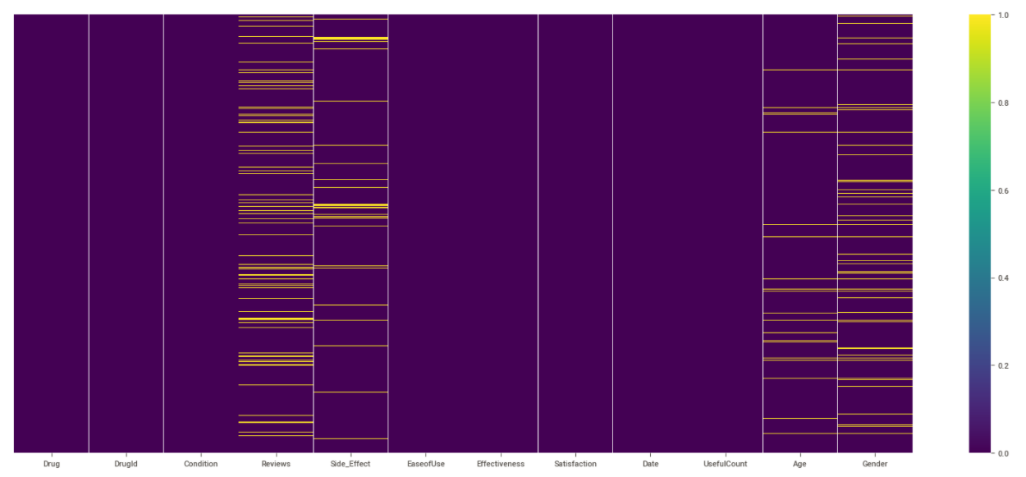
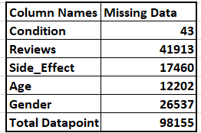
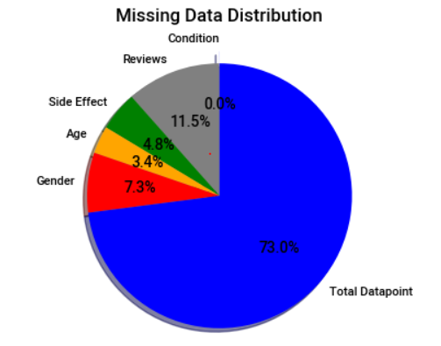
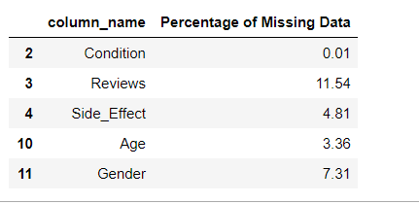
EDA: Missing Column Data Analysis
Missing Datapoint
Missing Dataset

Slide 9
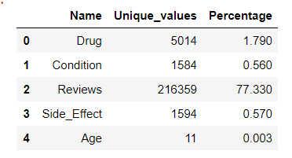
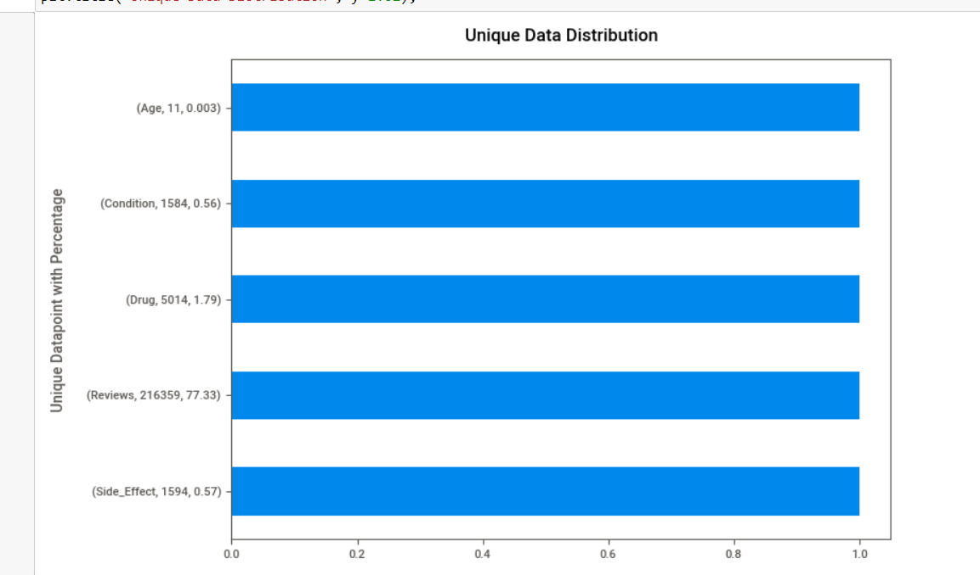
Exploratory Data Analysis (EDA):
Unique Dataset

Slide 10
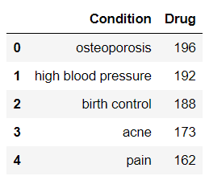
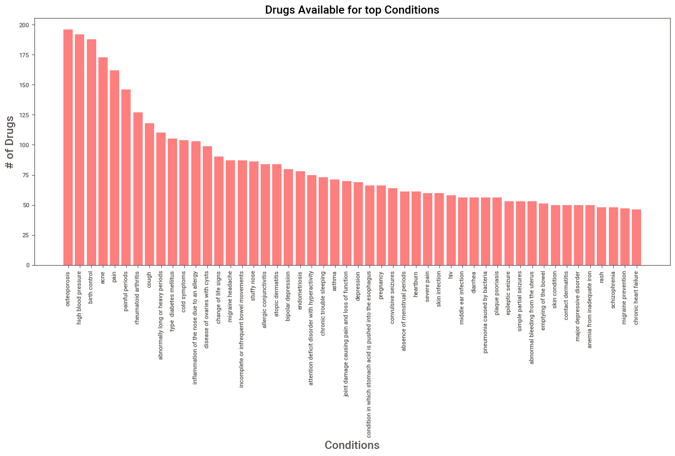
EDA: Column Wise Data Analysis
Drugs Distribution per Conditions
Observation- This graphical presentation shows the drugs availability for top condition. There are 200 drugs available to treat condition like Osteoporosis, Birth Control, acne, Pain and High BP etc.

Slide 11
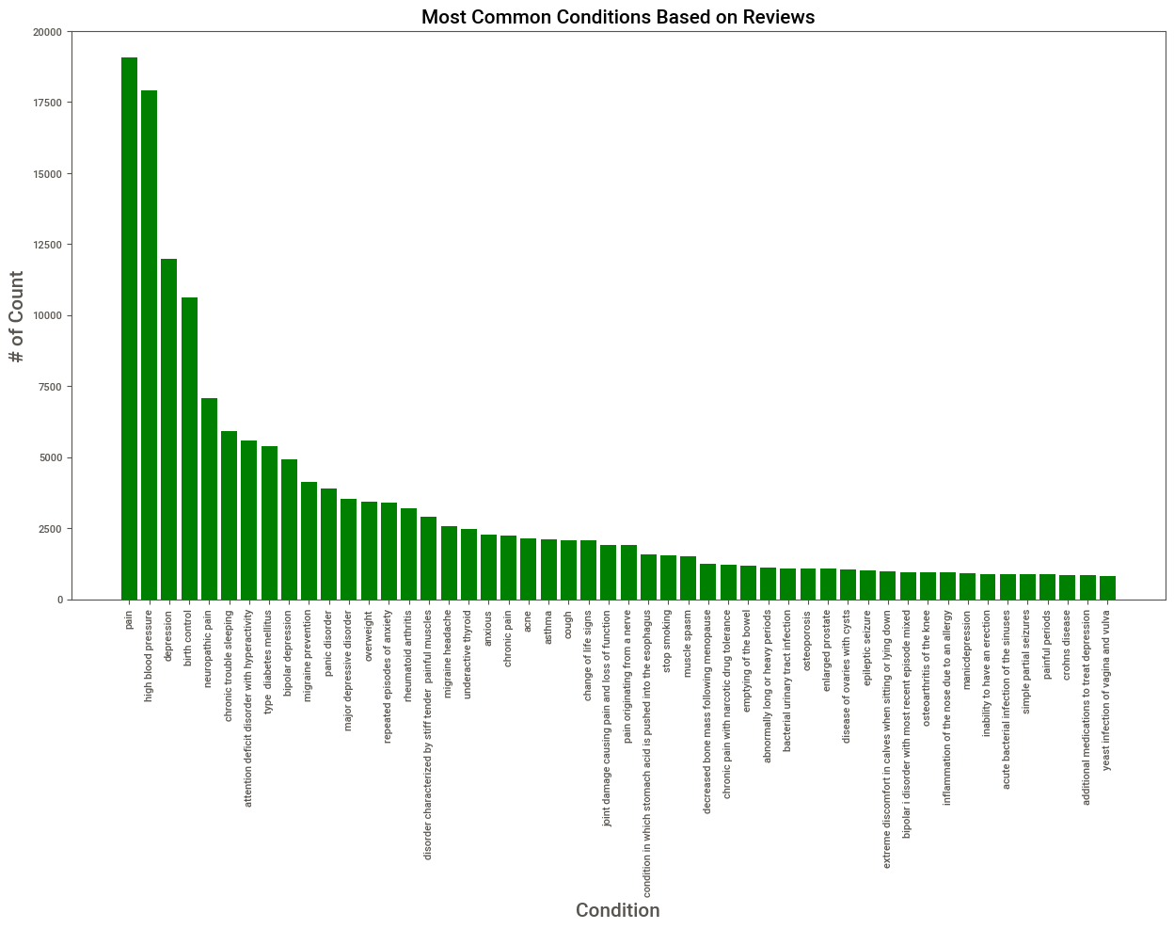
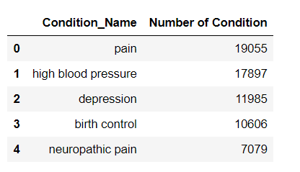
EDA: Column Wise Data Analysis
Most Common Condition based on Reviews
Observation- The above bar plot points out the most common condition among drug users. Pain, High BP, Depression and Birth Control are the top condition.

Slide 12
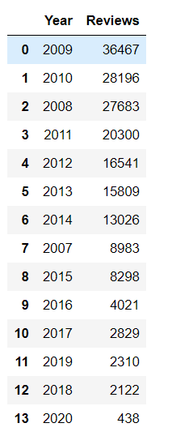
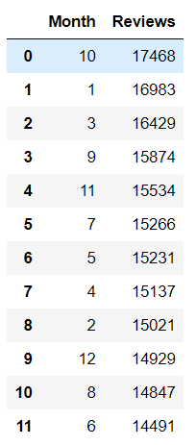
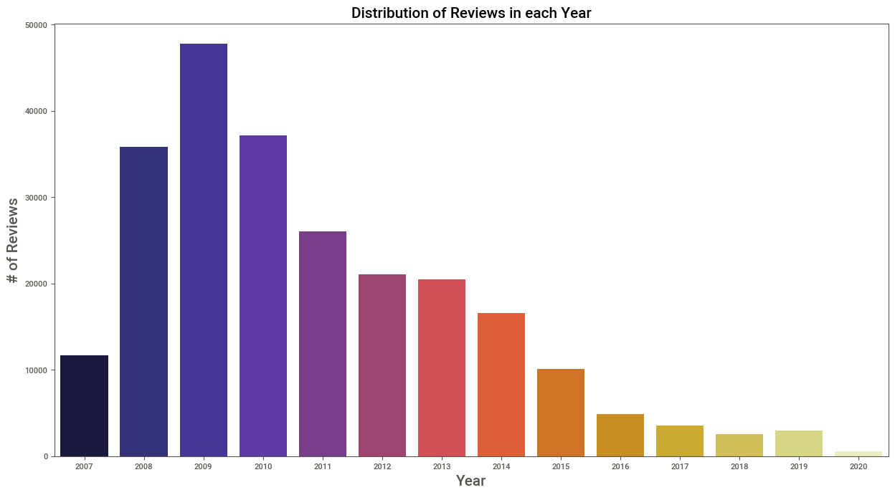
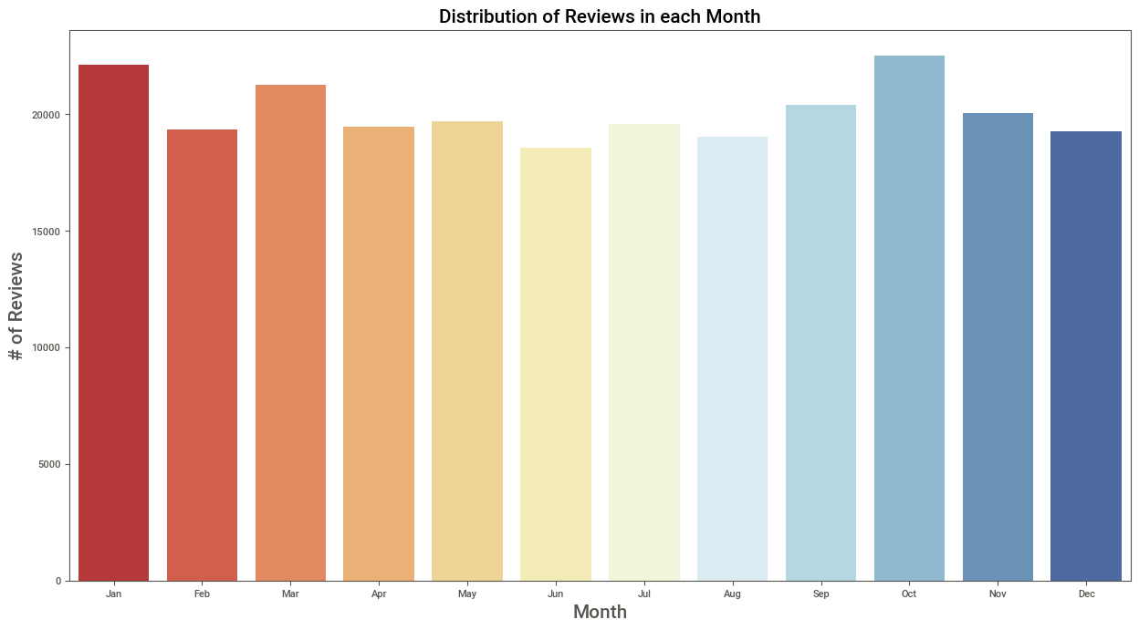
EDA: Column Wise Data Analysis
Distribution of Reviews in Each Year
Observation- The above bar plot shows the distribution of reviews for each year and month. In 2009 and Jan, Oct month, we can see highest reviews given by the user.

Slide 13
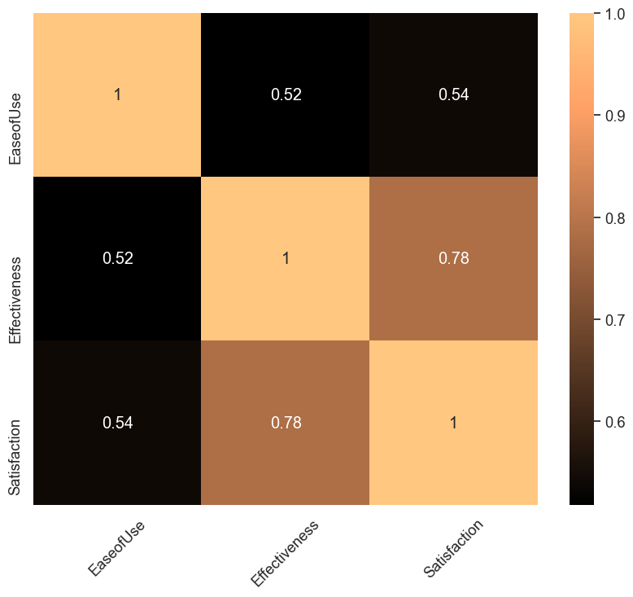
EDA: Column Wise Data Analysis
Correlation Matrix for Rating Dataset Selection
Observation- The above heatmap indicates about drug effectiveness is highly correlated with satisfaction. That's reason we have selected satisfaction column for our rating analysis.

Slide 14
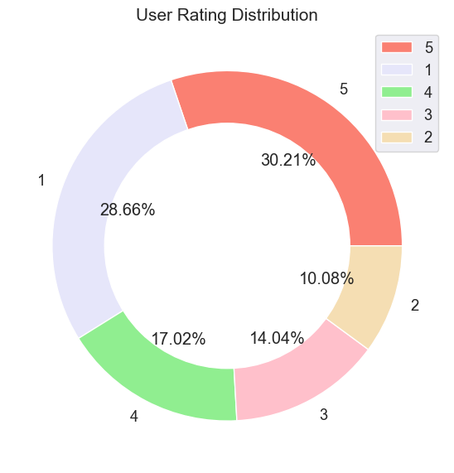
EDA: Column Wise Data Analysis
Rating Distribution
Observation- The above donut chart shows how ratings from scale 1 to 5 are distributed in our dataset. As we can see the majority of users have given a higher rating as compared to lower ones.

Slide 15
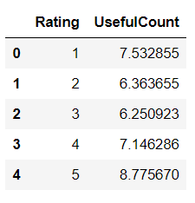
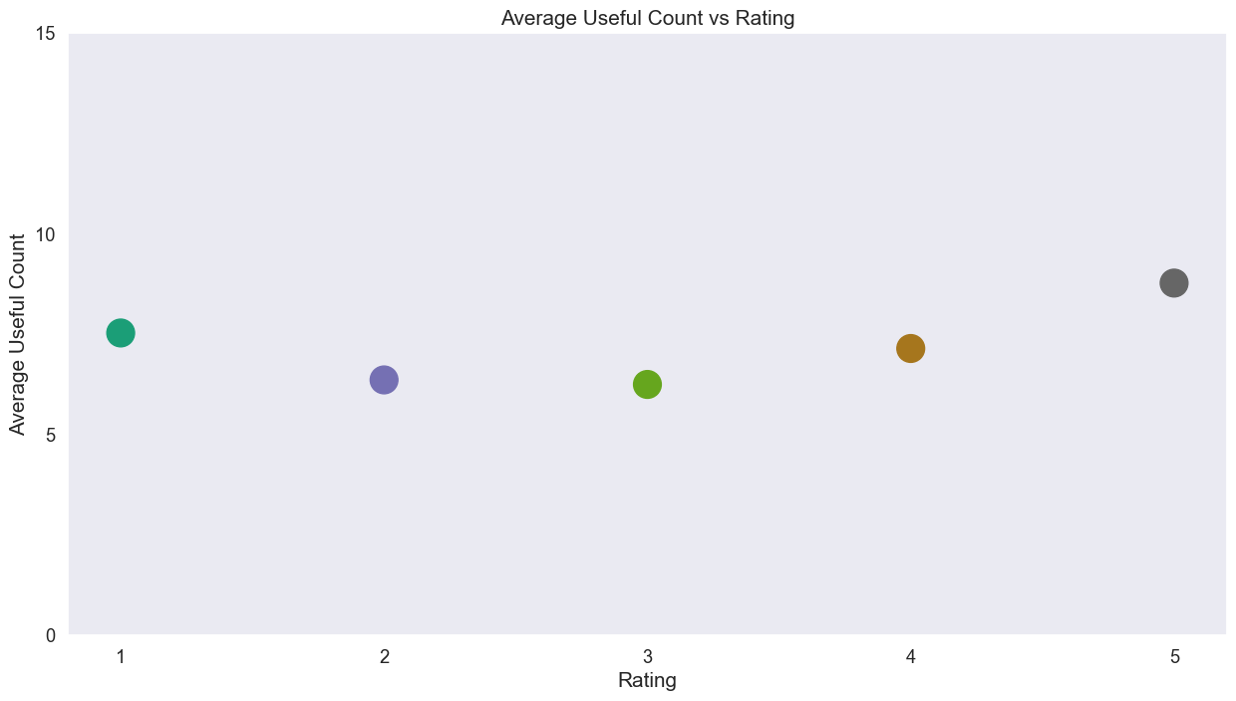
EDA: Column Wise Data Analysis
Useful Count vs Rating
Observation- The above scatter plot indicates about users who found review useful. The plot shows a slightly U shape trend the average useful count of a review versus overall rating.

Slide 16
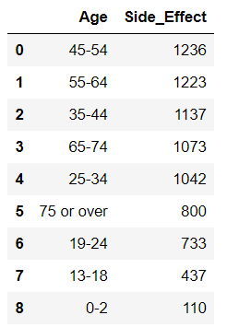
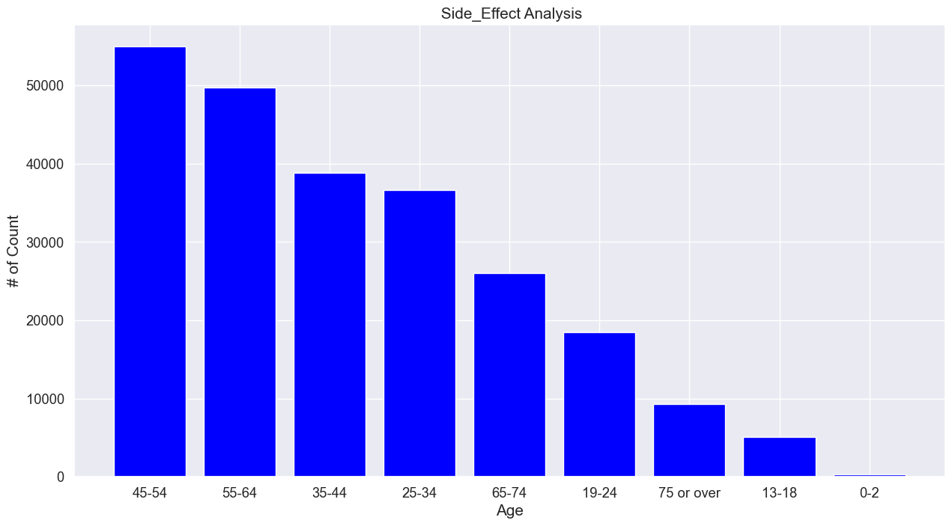
EDA: Column Wise Data Analysis
Side Effect Analysis Based on Age Factor
Observation - The above bar chart indicates correlation between Side-Effect and Age factor. as per visualization drug side effects impacting more on people age between 45-54.

Slide 17
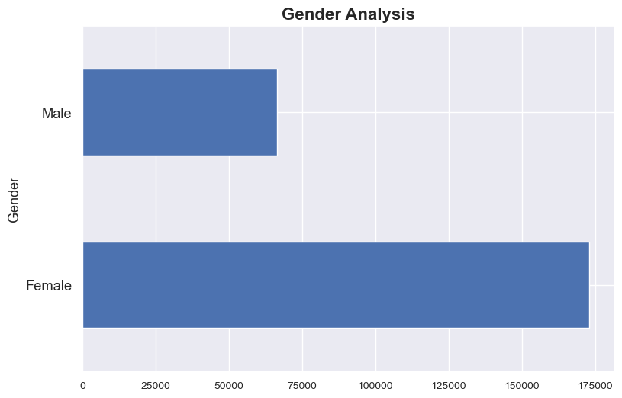

EDA: Column Wise Data Analysis
Gender Analysis Based on Drugs
Observation- The above bar chart shows how drug is impacting on gender, as per chart Female is consuming more drugs.

Slide 18
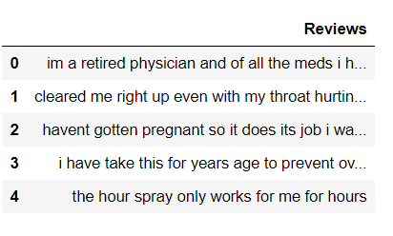
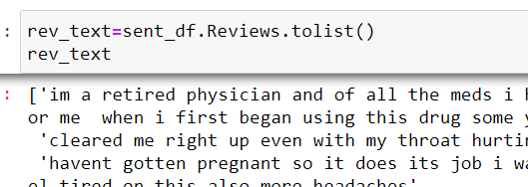
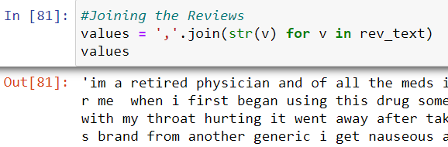
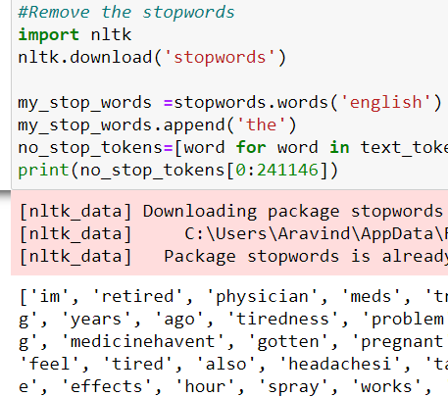
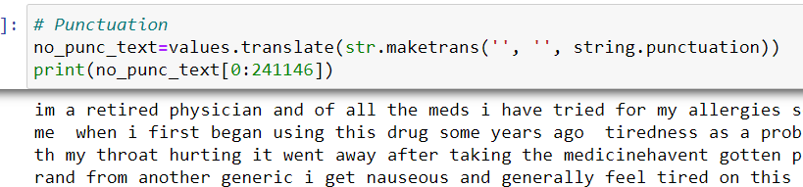
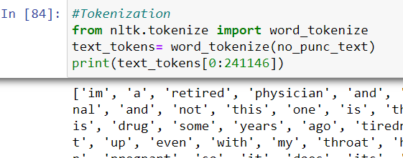
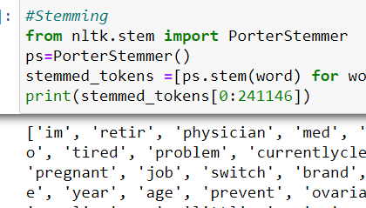
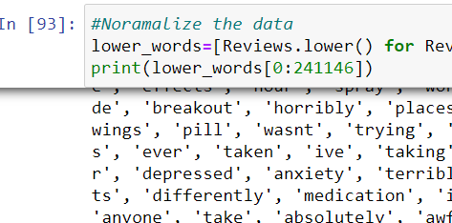
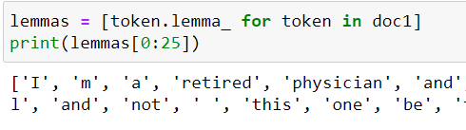
Sentiment Analysis
Before doing Sentiment Analysis we have done data pre-process

Slide 19
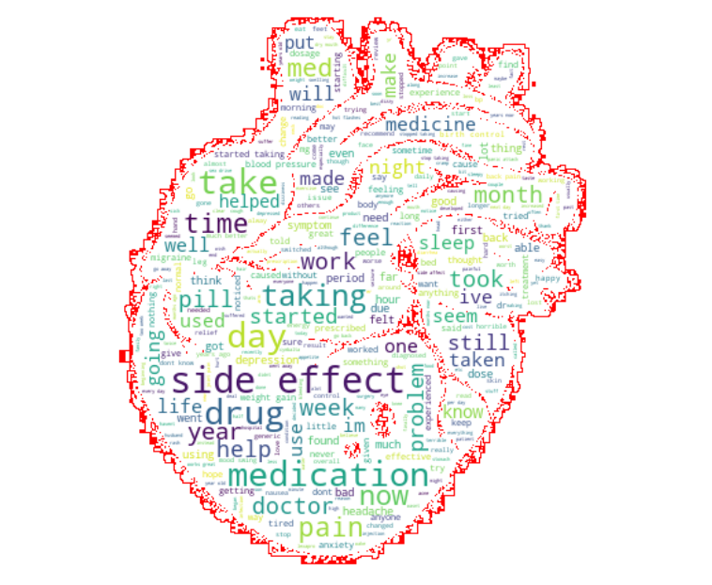
Sentiment Analysis
Word Cloud

Slide 20
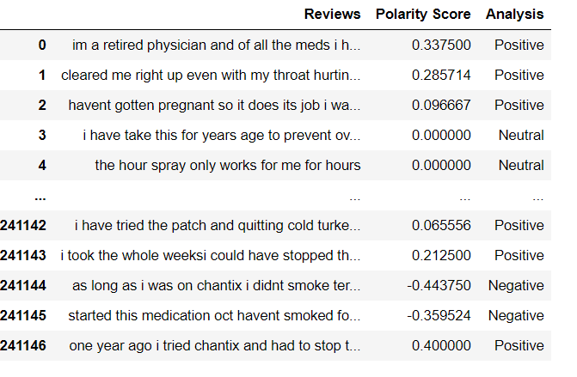
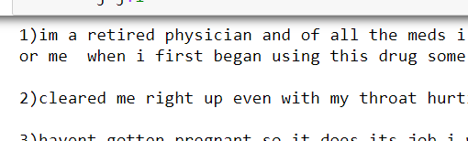
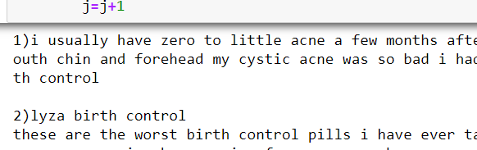
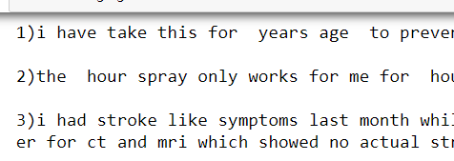
Sentiment Analysis
Polarity Score
Segregated Reviews
Print all the Positive Reviews
Print all the Negative Reviews
Print all the Neutral Reviews

Slide 21
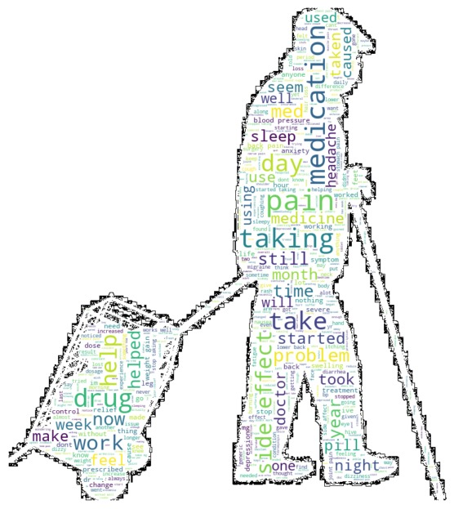

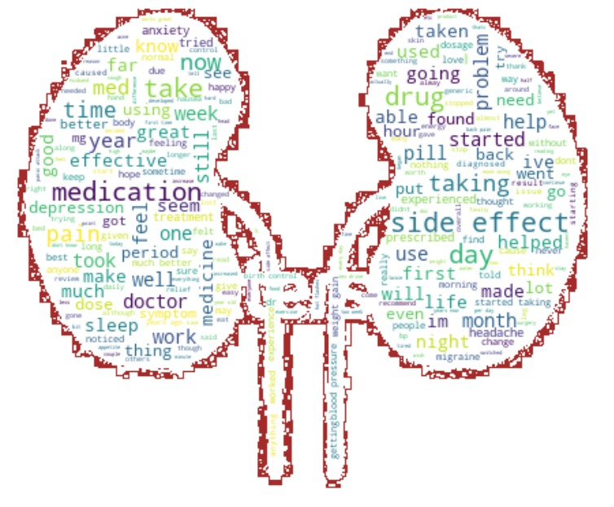
Sentiment Analysis
Word Cloud
Positive
Negative
Neutral

Slide 22
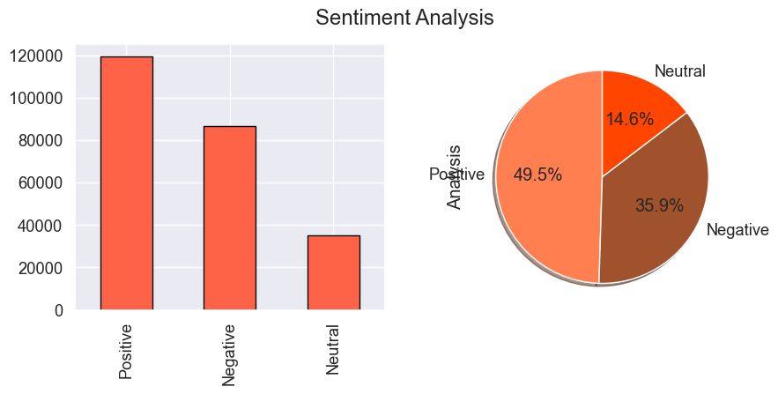
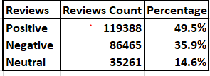
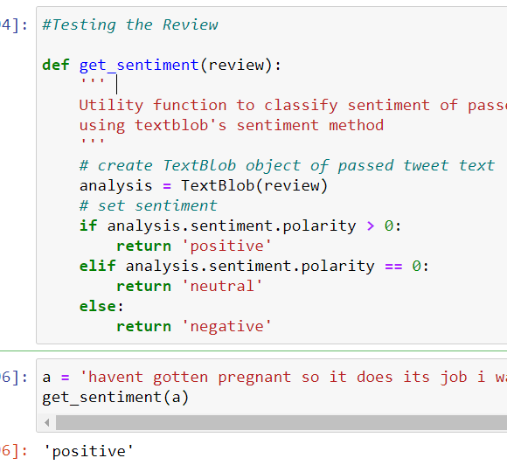
Sentiment Analysis
Observation- The above bar and pie chart shows how reviews are distributed , as per graph 49.5% positive reviews are given by the consumer.

Slide 23
Model Building

Slide 24
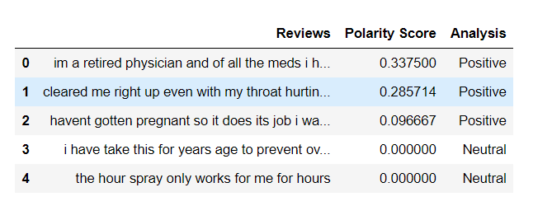
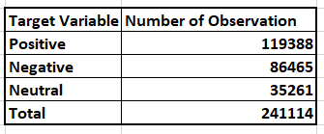
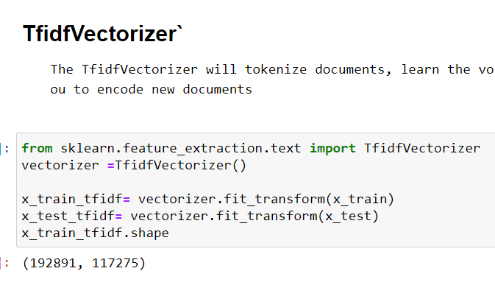
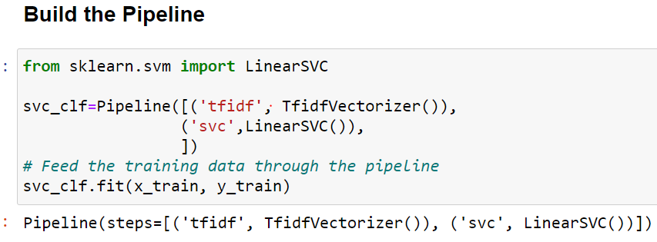
Model Building Summary
Dataset
Note:- We have created models with Tfidf Vectorizer and passed the model through Pipeline process

Slide 25
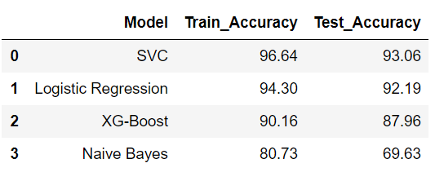
Model Building
Data Partition
Model Building Inference
Train= 80% (192891)
Test= 20% (48223)
Independed Variable = Reviews
Target Variable = Analysis(Positive, Negative, Neutral)
The highest accuracy in our analysis was given by the Logistic Regression model with TF-IDF vectorizer, which we then chose it as the best model with an accuracy of train- 94.30% and test- 92.12

Slide 26
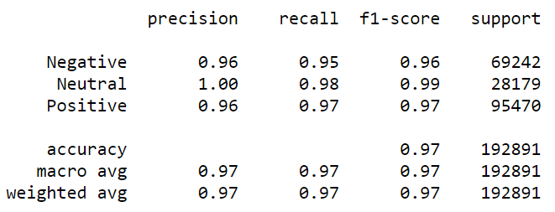

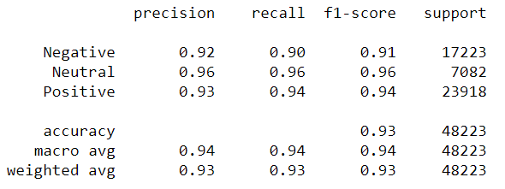

Model 1: Support Vector Classifier
Train Model Accuracy
Class Wise Accuracies
Train
96.64
Test Model Accuracy
93.06
Confusion Matrix
Train
Test
Test

Slide 27




Model 2: Logistic Regression
Train Model Accuracy
Class Wise Accuracies
94.03
Train
Test Model Accuracy
92.19
Confusion Matrix
Train
Test
Test

Slide 28




Model 3 : XG- Boost
Train Model Accuracy
Class Wise Accuracies
90.16
Train
Test Model Accuracy
87.96
Confusion Matrix
Train
Test
Test

Slide 29




Model 4: Naïve Bayes
Train Model Accuracy
Class Wise Accuracies
Train
80.73
Test Model Accuracy
69.63
Confusion Matrix
Train
Test
Test

Slide 30

Deployment Plan

Slide 31
Challenges faced?
While Collecting the data we faced some challenges- We were not able to fetch the data as per requirement.
While doing EDA process, we faced some challenges- When we check the missing column data using python code, we found less columns, but our data file contained lots of missing column data.
While doing condition columns, analysis we faced some challenges- While doing condition column analysis, we found around 38000 other condition data point because of this it was impacting to our analysis.
How did you overcome?
We tried to fetch the data using the beautiful-soup method, but we could not then we started researching, finally we found new the auto-scraper library, using this library we fetch the data as per requirement.
We filled the NAN values in our data file, then we ran python code.
We decided to drop other condition data.

Slide 32
Thank you

